Slide 1
Customer Selection Optimization 04/15/2020
Group 14
-Praveen Jayasankar
-Saanthakumaran
Mohanasundaram

Slide 2
Customer Selection Optimization
Problem Definition
Data Description
Data Exploration
Data Mining Task
Data Mining Models
Performance Evaluation
Project results
Impact of the Project outcomes

Slide 3

Problem Definition
Insurance Company wants to optimize the customer selection based on detail provided while filling online application form for loan approval.
To automate this process, we are creating a prediction model to determine whether the customer will be granted loan, so that they can specifically target these customers to persuade them to get the life insurance policy.

Slide 4
Data Description
Source: https://www.kaggle.com/ninzaami/loan-predication
614 Rows and 13 columns
Major Predictors :
Gender Marital Status
Education Loan Amount
Income Credit History
Self employed Property Area
Dependents Co-Applicant Income

Slide 5
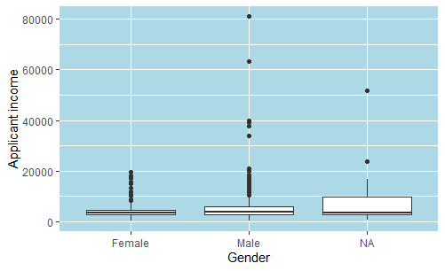
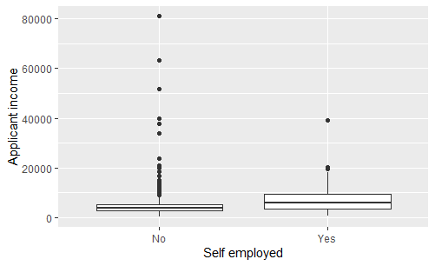
Data Exploration
There are 149 missing values
Cleaning techniques
Imputation
Exact Bayes Conditional Probability
Relation between predictors
Relation between predictor and response

Slide 6
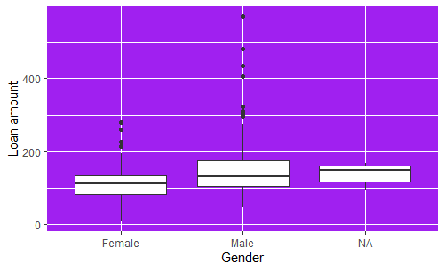
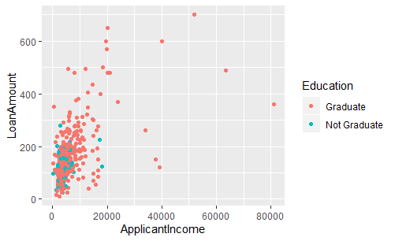
Data Exploration Cont.
Relationship Between Gender and Loan Amount
Relationship between Applicant Income and Loan Amount based on Education

Slide 7
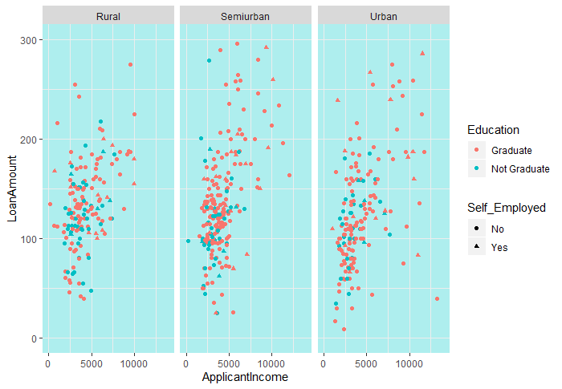
Data Exploration Cont.
Relationship between Applicant Income and Loan Amount classified based on property area , Education and Employment.

Slide 8
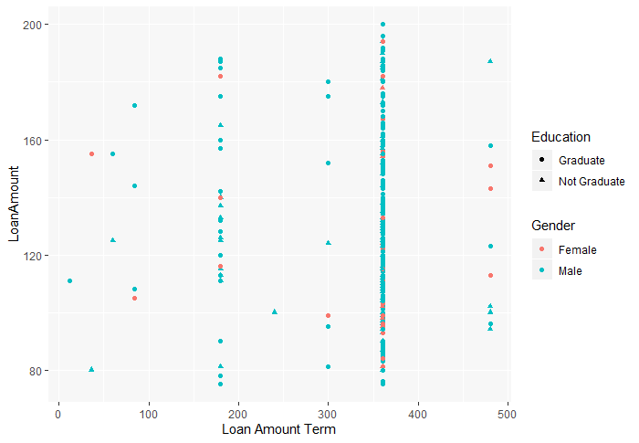
Data Exploration Cont. Relationship between Loan Amount and loan amount term classified based on Education and Gender.

Slide 9
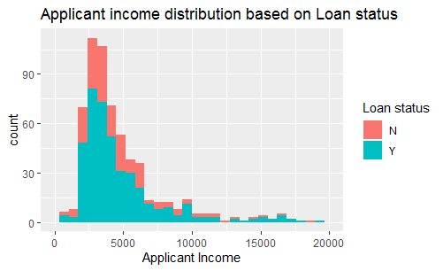
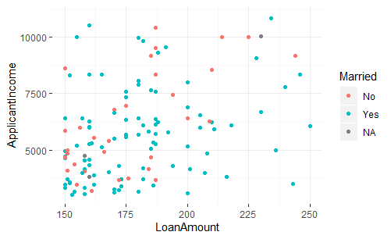
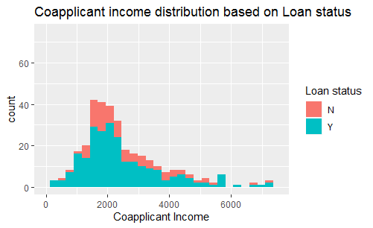
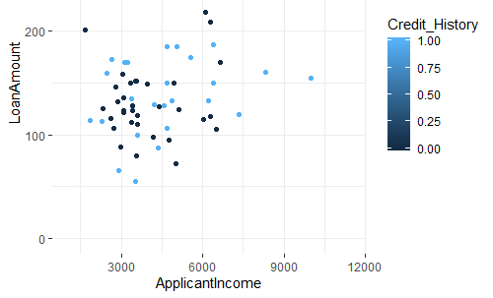

Slide 10
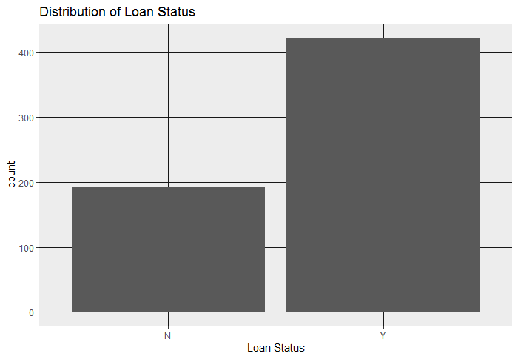
Data Mining Task
Converted Categorical Variables
to Dummy variables (Knn)
Scaled the numerical variables (Knn)
Binned the numerical variables ( Naïve Bayes)
Oversampled the training set to equalize the distribution.

Slide 11
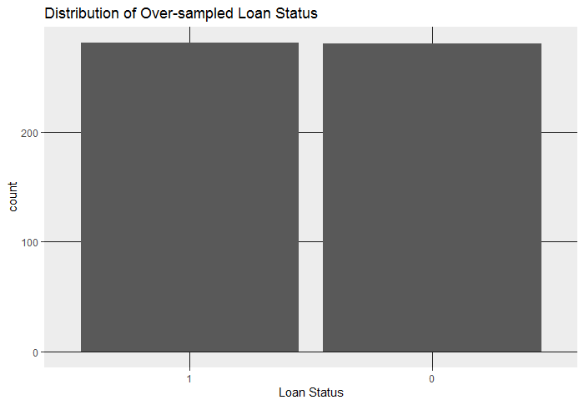
Data Inference
Total Data Processed= 614 records
Train data- 66.67% of the total data -> 409 records
Over-sampled train data-> 561 records with balanced distribution
Test data-33.33% of the total data-> 205 records

Slide 12
Data Mining Models
K-NN Model
Naïve Bayes Classifier
Decision tree
Random Forrest

Slide 13
Performance Evaluation
Sensitivity – Our target is to determine maximum percentage of loan approved customers ( )
Positive Predictive Value- We can’t afford to spend time and money with loan unapproved customers. ( )
F1-score – Perfect metrics to balance both Sensitivity and Positive Predictive Value. ( )
ROC curve
Decile chart- To determine percentage of loan approved customers to get maximum benefits.

Slide 14
Performance Evaluation

Slide 15
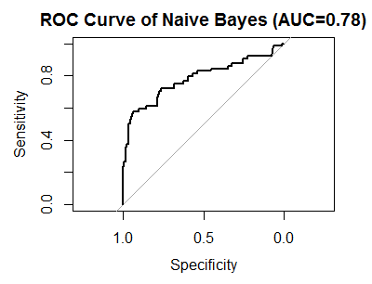
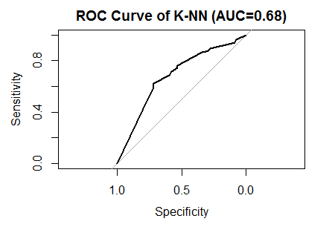
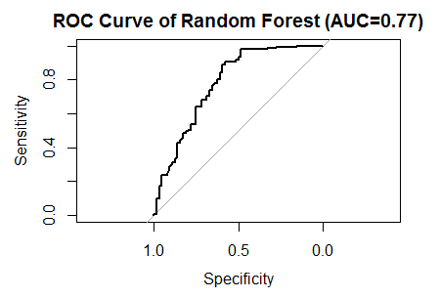
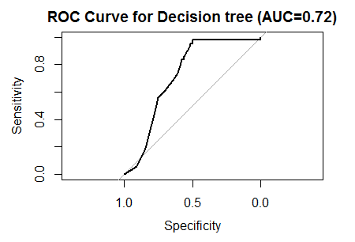

Slide 16
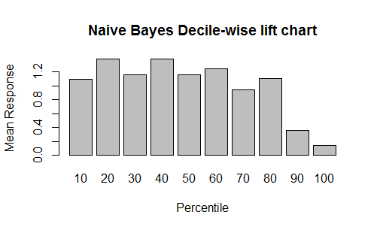
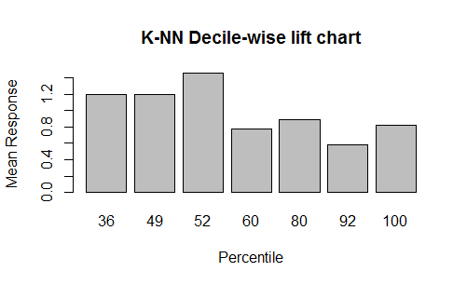
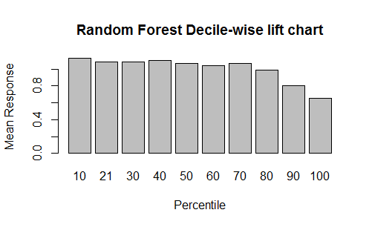
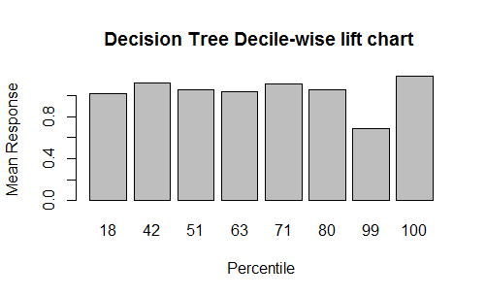
Decile Lift chart
Comparing the chart of
various model
By Naïve Bayes model, we can proceed with first 6 Deciles, in other words 60% of the customers.
By Random Forest model, first 7 deciles, in other words 70% of the customers can be considered.

Slide 17
Project Result
Naïve Bayes Classifier
Cut off =0.25
F1= 0.883
Sensitivity=0.964
Accuracy=0.824
Pos Pred value=0.81
Random Forest Model
Cut off=0.25
F1= 0.857
Sensitivity=0.978
accuracy=0.78
Pos Pred value=0.754

Slide 18

Insights for Decision making
Hence, both the Naive Bayes Model and the Random Forest Model can be used by the Insurance company to target the optimal number of customers to get maximum profits with
Minimum mis-classification cost
High sensitivity
High Accuracy

Slide 19

Impact of Project Outcomes
Using the Loan Eligibility Prediction model, the Insurance company would be able to segment the customers who are eligible for the loan accurately.
Hence, they can easily expand their customer network by selling their policies.
This would greatly benefit in terms of profit and contribute to the economic development of the company.

Slide 20
Thank you!!

